Slide 1
CN:CST31209 : Deep Learning and Big Data Intelligence
JING WEN
Spring 2021
Lecture 3:Backpropagation
Notes:
Where to put block multi-vector algorithms?
Percentage of Future Work
Diagram

Slide 2
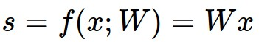

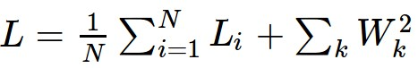
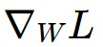
Where we are...
scores function
SVM loss
data loss + regularization
Compute gradients and steps to progressively improve the model via SGD and its variants.
i.e. want

Slide 3

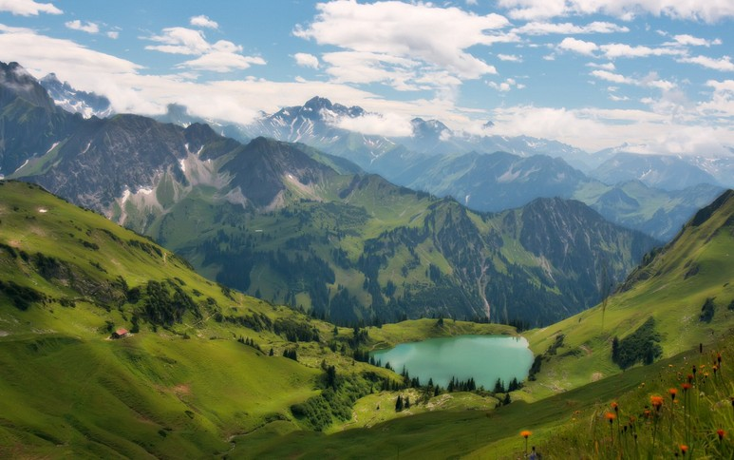

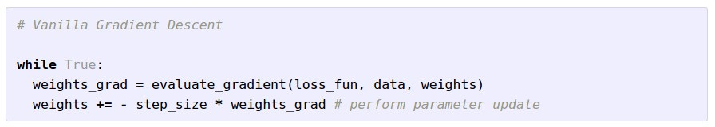
Optimization
(image credits
to Alec Radford)

Slide 4
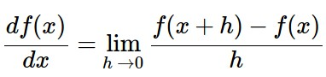
Gradient Descent
Numerical gradient: slow :(, approximate :(, easy to write :)
Analytic gradient: fast :), exact :), error-prone :(
In practice: Derive analytic gradient, check your implementation with numerical gradient

Slide 5
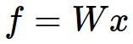
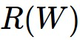
Computational Graph
x
*
s (scores)
hinge loss
+
L
W
R

Slide 6

Convolutional Network
(AlexNet)
input image
weights
loss

Slide 7
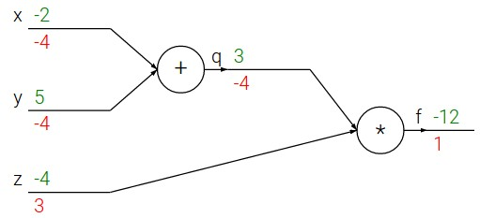
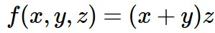
Differentiating a Computation Graph
e.g. x = -2, y = 5, z = -4

Slide 8
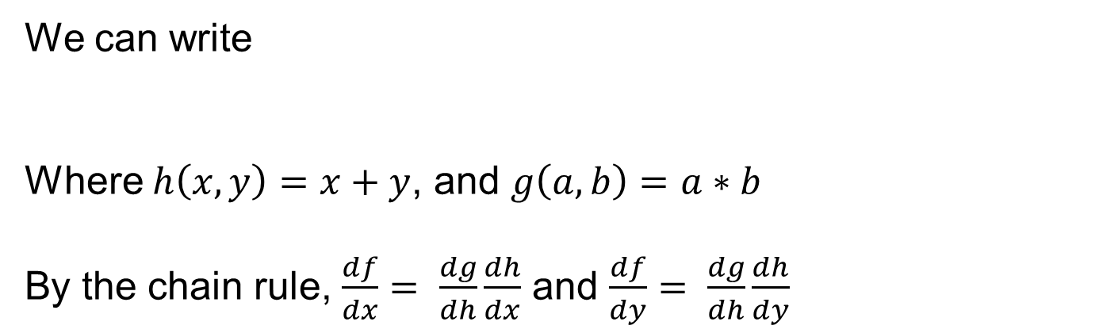
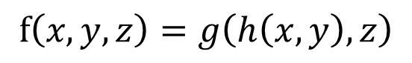
Chain rule
We can write
Where $h\left(x,y\right)=x+y$, and $g\left(a,b\right)=a∗b$
By the chain rule, $\frac{df}{dx}= \frac{dg}{dh}\frac{dh}{dx}$ and $\frac{df}{dy}= \frac{dg}{dh}\frac{dh}{dy}$
$$f\left(x,y,z\right)=g\left(h\left(x,y\right),z\right)$$

Slide 9
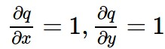
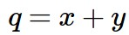
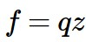
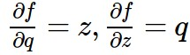
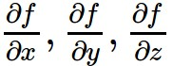
Differentiating a Computation Graph
e.g. x = -2, y = 5, z = -4
Want:

Slide 10
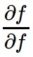
Differentiating a Computation Graph
e.g. x = -2, y = 5, z = -4
Want:

Slide 11
Differentiating a Computation Graph
e.g. x = -2, y = 5, z = -4
Want:

Slide 12
Differentiating a Computation Graph
e.g. x = -2, y = 5, z = -4
Want:

Slide 13
Differentiating a Computation Graph
e.g. x = -2, y = 5, z = -4
Want:

Slide 14
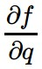
Differentiating a Computation Graph
e.g. x = -2, y = 5, z = -4
Want:

Slide 15
Differentiating a Computation Graph
e.g. x = -2, y = 5, z = -4
Want:

Slide 16
Differentiating a Computation Graph
e.g. x = -2, y = 5, z = -4
Want:

Slide 17
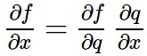
Differentiating a Computation Graph
e.g. x = -2, y = 5, z = -4
Chain rule:
Want:

Slide 18
Differentiating a Computation Graph
e.g. x = -2, y = 5, z = -4
Want:

Slide 19
Differentiating a Computation Graph
e.g. x = -2, y = 5, z = -4
Chain rule:
Want:

Slide 20
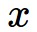
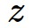
activations
f

Slide 21
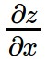
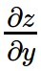
activations
f
“local gradient”

Slide 22
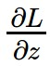
activations
f
“local gradient”
gradients

Slide 23
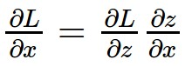
activations
f
“local gradient”
gradients

Slide 24
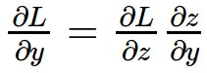
activations
f
“local gradient”
gradients

Slide 25
activations
f
“local gradient”
gradients

Slide 26
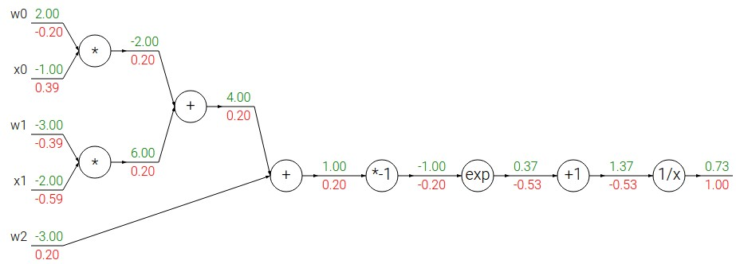
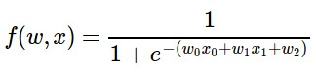
Another backprop example:

Slide 27
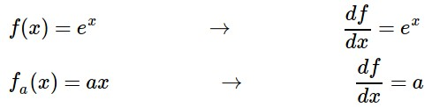
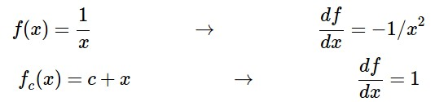
Another example:

Slide 28
Another example:

Slide 29
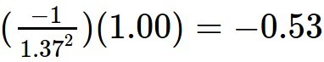
Another example:

Slide 30
Another example:

Slide 31
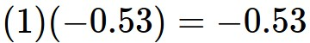
Another example:

Slide 32
Another example:

Slide 33
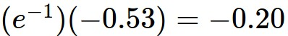
Another example:

Slide 34
Another example:

Slide 35
Another example:
(-1) * (-0.20) = 0.20

Slide 36
Another example:

Slide 37
Another example:
[local gradient] x [its gradient]
[1] x [0.2] = 0.2
[1] x [0.2] = 0.2 (both inputs!)

Slide 38
Another example:

Slide 39
Another example:
[local gradient] x [its gradient]
x0: [2] x [0.2] = 0.4
w0: [-1] x [0.2] = -0.2
0.40

Slide 40
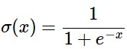
sigmoid function
0.40
sigmoid gate
0.40
0.60

Slide 41
sigmoid function
0.40
sigmoid gate
0.40
0.60
(0.73) * (1 - 0.73) = 0.2

Slide 42
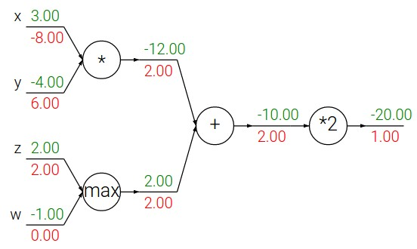
Patterns in backward flow
add gate: gradient distributor梯度分发
max gate: gradient router 梯度路由
mul gate: gradient… “switcher”? 梯度交换

Slide 43
Gradients add at branches
Copy gate梯度相加
7
7
2
+
2+4=6
4
7

Slide 44
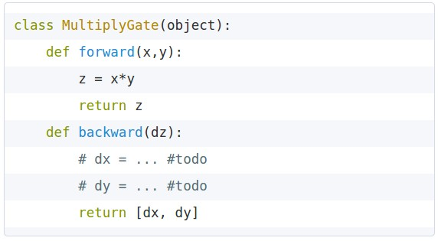
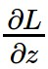
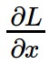
Implementation: forward/backward API
x
z
*
y
(x,y,z are scalars)

Slide 45
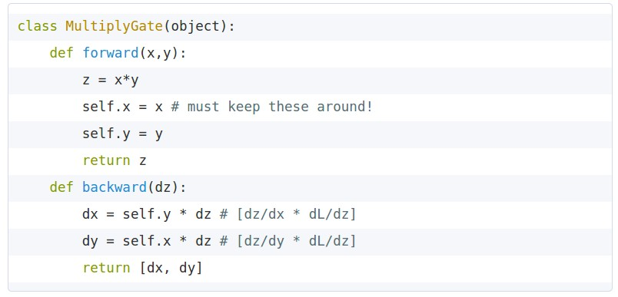
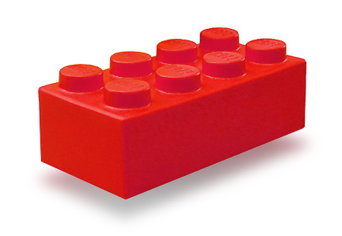
Implementation: forward/backward API
x
z
*
y
(x,y,z are scalars)

Slide 46
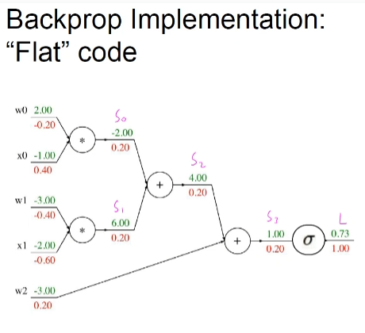
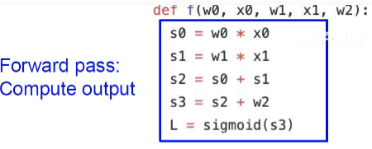
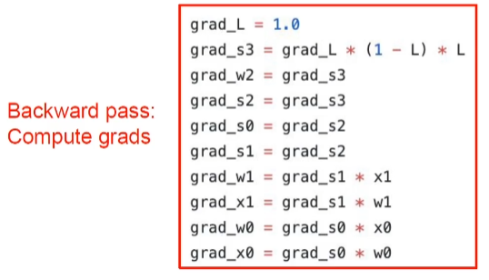

Slide 47
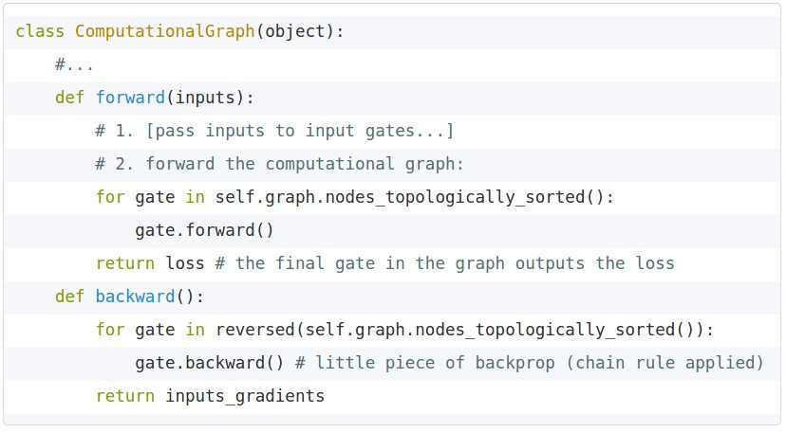
Implementation: forward/backward API
Graph (or Net) object. (Rough psuedo code)

Slide 49
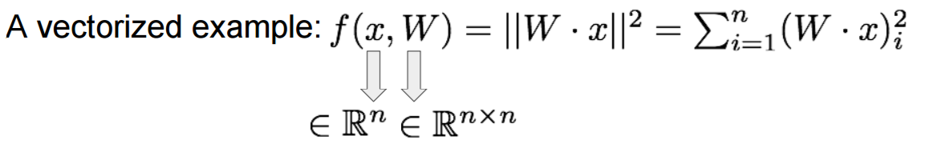

Slide 50
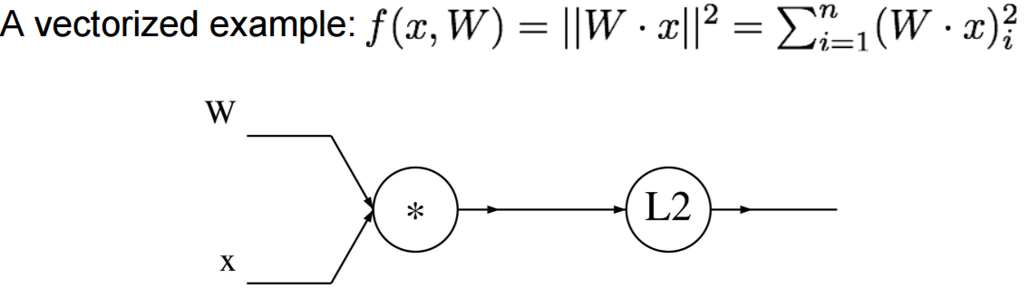

Slide 51
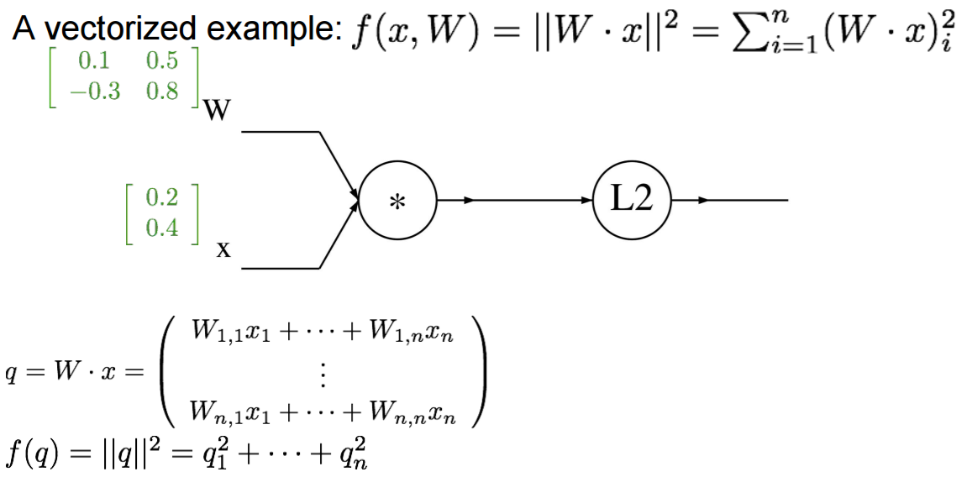

Slide 52
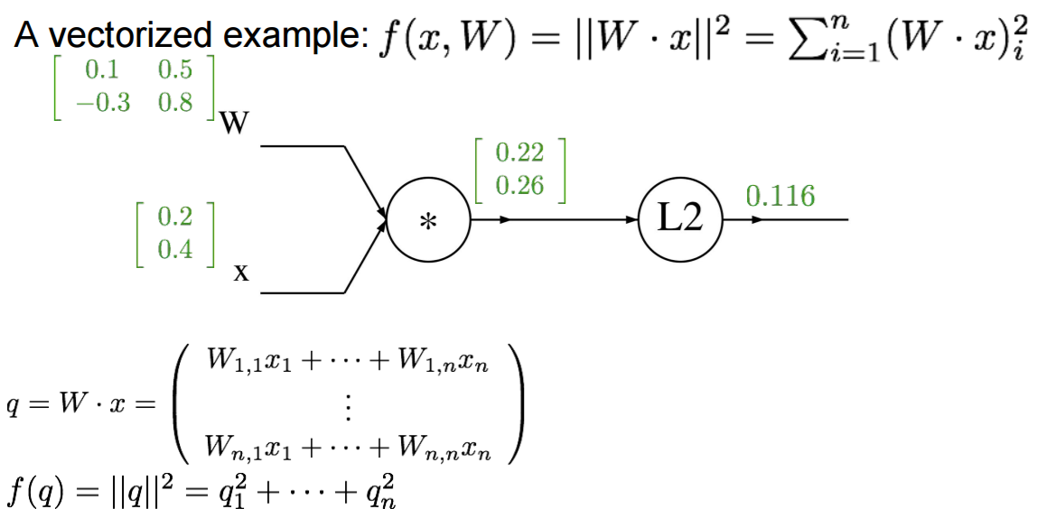

Slide 53
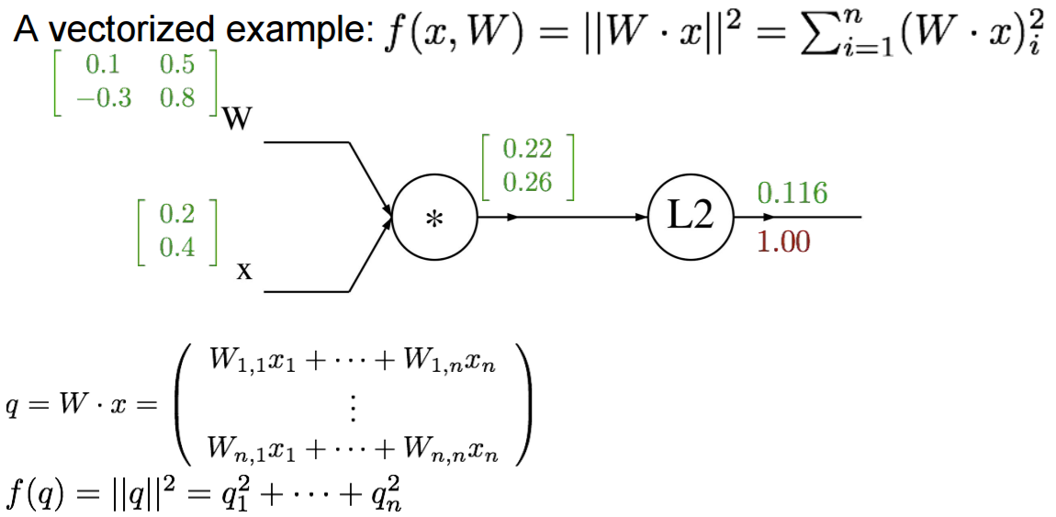

Slide 54


Slide 55


Slide 56



Slide 57




Slide 58
Vectorized operations
f(x) = max(0,x)
(elementwise)
4096-d
input vector
4096-d
output vector

Slide 59

Vectorized operations
f(x) = max(0,x)
(elementwise)
Jacobian matrix
4096-d
input vector
4096-d
output vector
Q: what is the size of the Jacobian matrix?

Slide 60

Vectorized operations
max(0,x)
(elementwise)
f(x) = max(0,x)
(elementwise)
Jacobian matrix
4096-d
input vector
4096-d
output vector
Q2: what does it look like?
Q: what is the size of the Jacobian matrix?
[4096 x 4096!]

Slide 61
Gradients for vector data
This is now the Jacobian matrix (derivative of each element of z w.r.t. each element of x)
(x,y,z are now vectors)
f
Dx
Dx*Dz
Dz
Dy*Dz
Dy
“local gradient”
gradients

Slide 62
Gradients for vector data
4-d
input vector x
f(x) = max(0,x)
(elementwise)
[1]
[-2]
[3]
[-1]
[1]
[0]
[3]
[0]
dL/dx
Jacobian matrix
dL/dy
[4]
[0]
[6]
[0]
$$\left[\begin{matrix}\begin{matrix}1 & 0\end{matrix} & \begin{matrix}0 & 0\end{matrix}\end{matrix}\right]$$
[4]
[-1]
[6]
[9]
$$\left[\begin{matrix}\begin{matrix}0 & 0\end{matrix} & \begin{matrix}0 & 0\end{matrix}\end{matrix}\right]$$
$$\left[\begin{matrix}\begin{matrix}0 & 0\end{matrix} & \begin{matrix}1 & 0\end{matrix}\end{matrix}\right]$$
$$\left[\begin{matrix}0 & \begin{matrix}0 & \begin{matrix}0 & 0\end{matrix}\end{matrix}\end{matrix}\right]$$

Slide 63
vectorized operations
in practice we process an entire minibatch (e.g. 100) of examples at one time:
max(0,x)
(elementwise)
f(x) = max(0,x)
(elementwise)
100 4096-d
input vectors
100 4096-d
output vectors
i.e. Jacobian would technically be a
[409,600 x 409,600] matrix :\
Why don’t we compute it that way?

Slide 64


Slide 65




Slide 66


Slide 67

y11=x11*w11+x12*w21+x13*w31

Slide 68


Slide 69


Slide 70


Slide 71

0
3*2+2*3+1*(-3)+(-1)*9=0

Slide 72

-30

Slide 73

tensor operations
tensor

Slide 74
tensor operations
(x,y,z are now tensor)
Dx*Mx
f
Dz*Mx
Dy*My

Slide 75
tensor operations
(x,y,z are now tensor)
f
Dx*Mx
(Dx*Mx)*(Dz*Mz)
Dz*Mz
(Dy*My)*(DzMz)
Dy*My
“local gradient”
gradients

Slide 76
Q: Why is it back-propagation?
complex graph
inputs x
outputs y

Slide 77

Why is it back-propagation? i.e. why go backwards?
complex graph
inputs x
outputs y
reverse-mode differentiation (if you want effect of many things on one thing)
for many different x
forward-mode differentiation (if you want effect of one thing on many things)
for many different y

Slide 78
Why is it back-propagation? i.e. why go backwards?
complex graph
inputs x
outputs y
reverse-mode differentiation (if you want effect of many things on one thing)
for many different x
More common simply because many nets have a scalar loss function as output.

Slide 79


Example: Torch Layers

Slide 80



Example: Torch Layers
=

Slide 81


Example: Torch MulConstant
initialization
forward()
backward()

Slide 82


Example: Caffe Layers

Slide 83

Caffe Sigmoid Layer
*top_diff (chain rule)

Slide 84


Assignment: Writing SVM/Softmax
Stage your forward/backward computation!
margins
E.g. for the SVM:

Slide 85
Summary so far
neural nets will be very large: no hope of writing down gradient formula by hand for all parameters
backpropagation = recursive application of the chain rule along a computational graph to compute the gradients of all inputs/parameters/intermediates
implementations maintain a graph structure, where the nodes implement the forward() / backward() API.
forward: compute result of an operation and save any intermediates needed for gradient computation in memory
backward: apply the chain rule to compute the gradient of the loss function with respect to the inputs.

Slide 86
Next Lecture:
More than you ever wanted to know about Neural Networks and how to train them.

